Slide 1
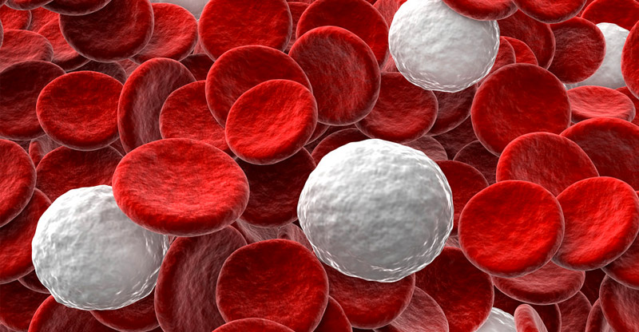
III. Immune System

Slide 3
What do each of these do?

Slide 4
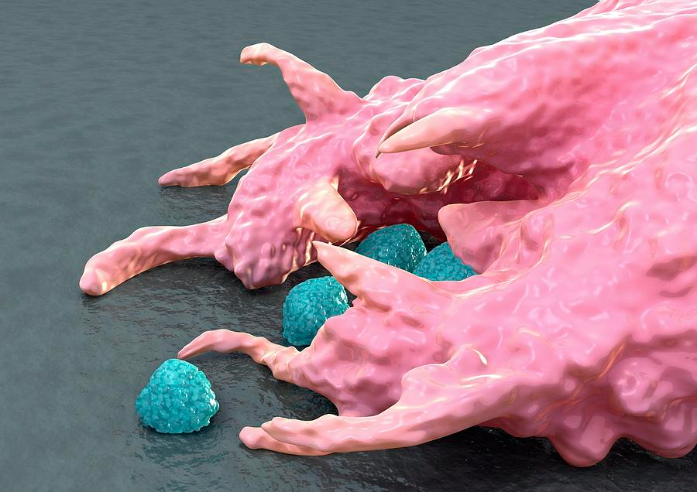
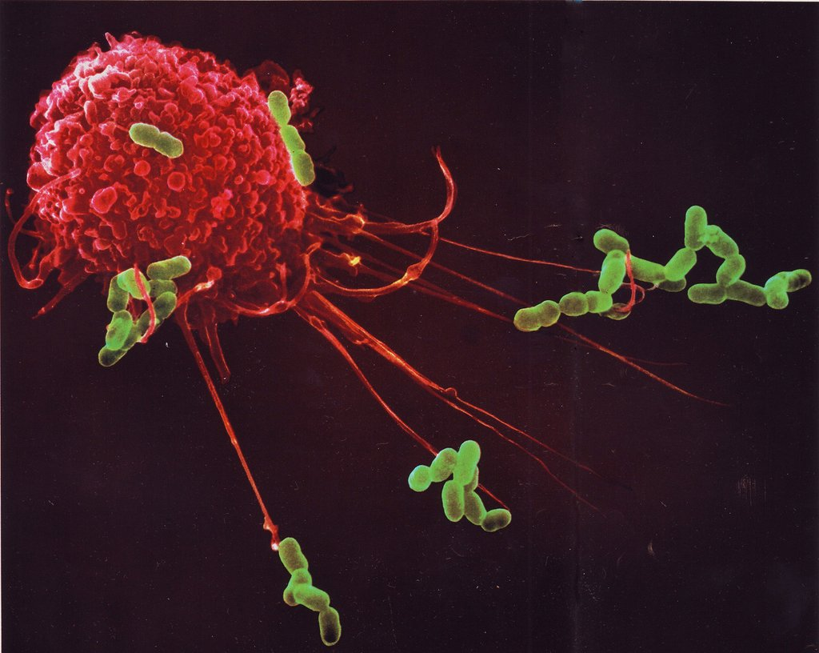
Macrophages engulf pathogens and other cells.

Slide 6
Remember
Antigen – Name Tag “hi my name is Jen!”
Antibody – Body Guard – these can tag pathogens for destruction

Slide 8
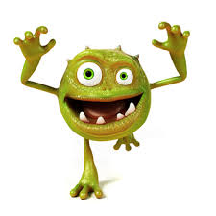
A. Functions
Prevent infection
Recognize and destroy foreign matter.
Germs
- Viruses
- Bacteria
- Protozoa
- fungi

Slide 11
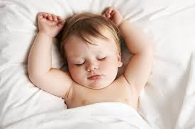
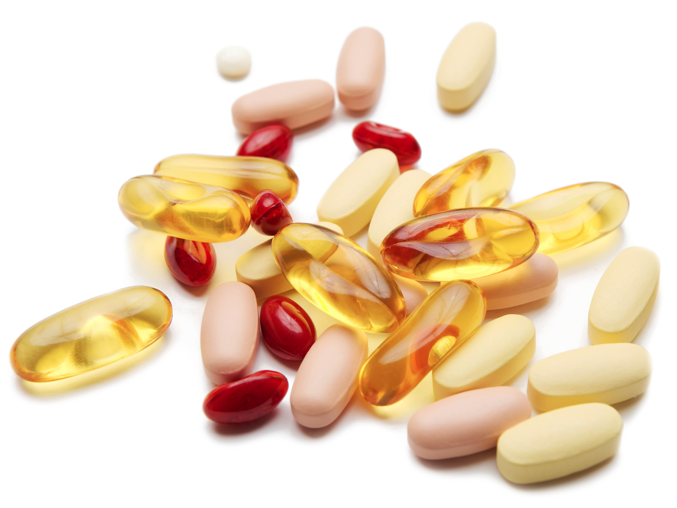
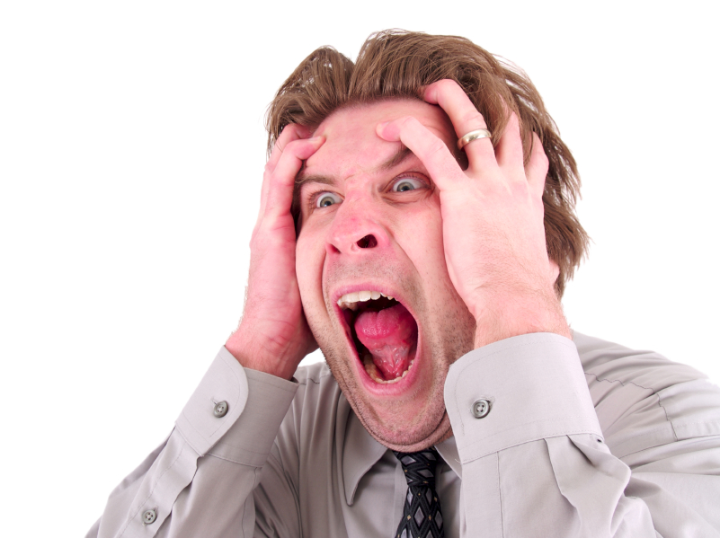
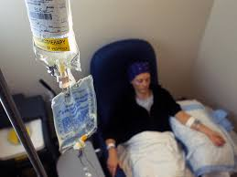
B. What can weaken Immune System?
Lack of sleep
Stress
Lack of correct vitamins
Chemo or other treatments

Slide 12
C. 2 Types of Diseases
1. Noninfectious Disease
Noncommunicable
Noncontagious
Not transmitter person to person
Caused by genetics of lifestyle choices
Most cancers, heart disease, hemophilia
2. Infectious Disease
Communicable
Contagious
Caused by germs
Transmitted person to person.
Flue, HIV, cold, Hep C

Slide 15
D. 2 Types of Immunity Immunity is the inability of a pathogen to infect an organism
Passive Immunity
Does not require and immune response
Genetic immunity
breastfeeding
Active Immunity
Occurs as a result of an immune system response to foreign antigens
Vaccines
Illness

Slide 16
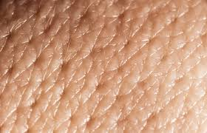
E. Types of Human Defenses
1. Nonspecific defense
Skin (largest one)
Openings tears, saliva, mucus, oils. Secretions have Lysozyme the break down cell walls

Slide 17
b. Inflammatory response and fever
If pathogen gets past skin – they trigger Mast Cells to release histamines.
Histamines – increase blood flow – make capillaries leakier!
White blood cells travel to pathogen to engulf and destroy.
Temperature increase also follows
Low fever – 101 and below – Good
Increases WBC and decreased pathogen
High fevers – 102 and above are dangerous
Beyond the hypothalmus

Slide 21
2. Specific defense systems
a. Recognizing “self” and “non-self”
b. Antigens – foreign tag that triggers response
c. Lymphocytes – B cells and T cells (Main workers in specific defense)
B cells – made in bone marrow
discover antigens in body fluids
T cell – made in marrow and mature in thymus
have to be presented with a antigen by infected cells.
Watch how it works

Slide 23
How do B and T Cells work???
Both are always searching the body
Humoral Response - B cells – Traveling in blood stream
Cellular Response – T Cells – Virus attacks a cell.
Both can make memory cells that “never forget”

Slide 26
F. Immune System Disorders
1. Allergies “antigens”- allergens (pollen, dander, peanuts) trigger inflammatory response
Antihistamines help reduce histamine
Anaphylaxes – Abnormal amount of histamine released due to an antigen

Slide 27
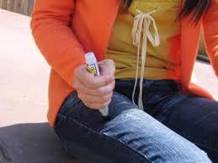

Slide 28
Asthma – air passages narrow due to resp. infection, exercise, stress and allergens.
Autoimmune diseases
- Type I diabetes, rheumatoid arthritis, lupus

Slide 29
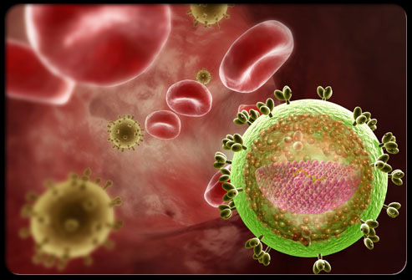
4. AIDS – retrovirus that weakens and destroys T cells
First suspected due to rare infections

