Slide 1
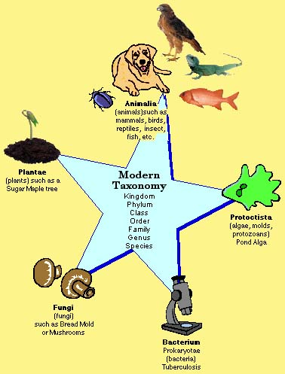
Taxonomy:
TAXONOMY
The Science of Classification

Slide 2
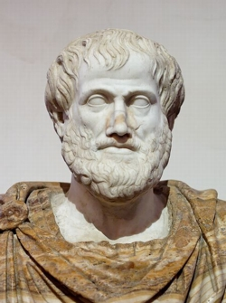
History of classification
384-322 B.C. – Aristotle
Created scheme
Two groups
Animal- Land, air, water
Plant – herbs, shrubs, trees
What kind of problems could this create?
Tall grasses? Frogs?

Slide 3
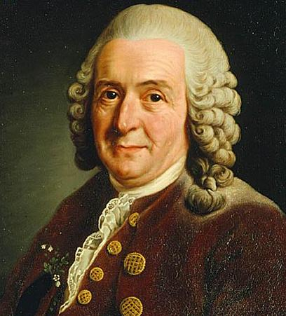
1700’s Linnaeus
Established a simple system
Base on structural similarities
Binomial Nomenclature – 2 name naming system – still used today
Created groups called taxa
Human Beings=Homo sapiens Frog=Rana tigrina Mustard=Barrasica compestris

Slide 4
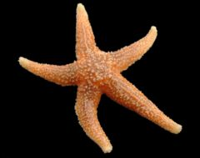
Modern Day Levels of Classification
Kids | Playing | Catch | On | Freeway | Get | Squashed
King | Philip | Came | Over | From | Great | Spain
Kingdom | Phylum | Class | Order | Family | Genus | Species
Animalia | Echinodermata | Asteroidea | Forcipulatida | Asteriidae | Asterias | rubens

Slide 5
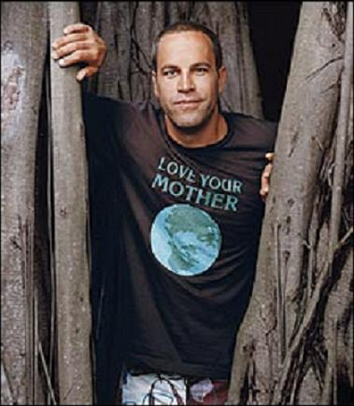
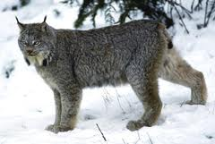
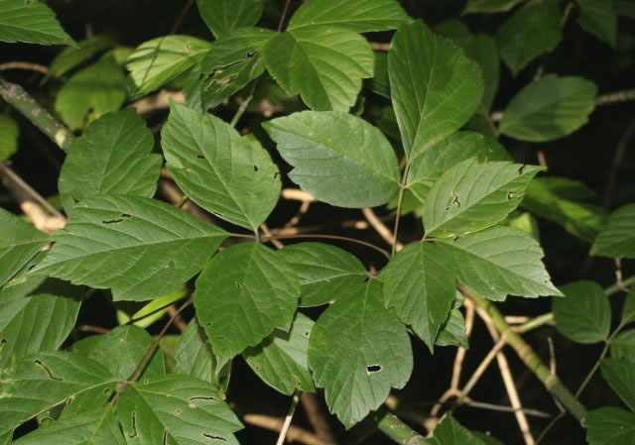
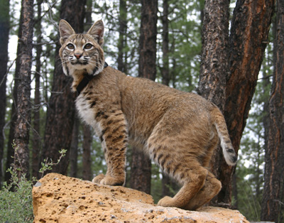
 | Man | Box Elder Tree | Bobcat | Canadian lynx
Kingdom | Animalia | Plantea | Animalia | Animalia
Phylum | Chordata | Anthophyta | Chordata | Chordata
Class | Mammalian | Dicotyledonae | Mammalia | Mammalia
Order | Primates | Sapindales | Carnivora | Carnivora
Family | Hominidae | Aceracae | Felidae | Felidae
Genus | Homo | Acer | Lynx | Lynx
Species | sapiens | nugundo | rufus | canadensis

Slide 6
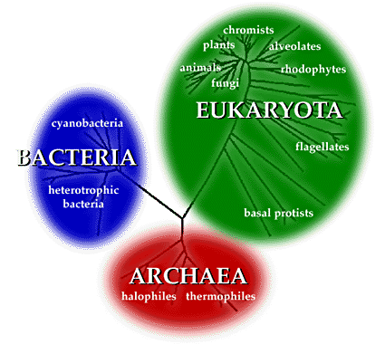
Before Kingdom…
3 Domains
Bacteria, Archae and Eukarya

Slide 7
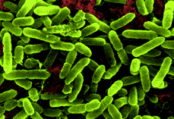
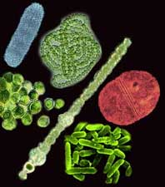
Kingdom Monera
Prokaryotes
Heterotrophic and autotrophic
Anaerobic and aerobic
Aquatic, terrestrial, in air
Mostly asexual
Mostly non-motial
Ex: bacteria, archebacteria

Slide 8
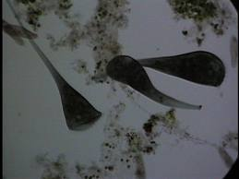
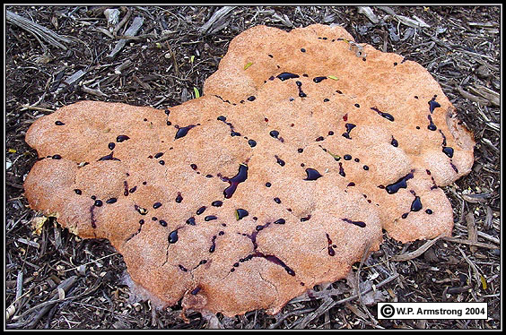
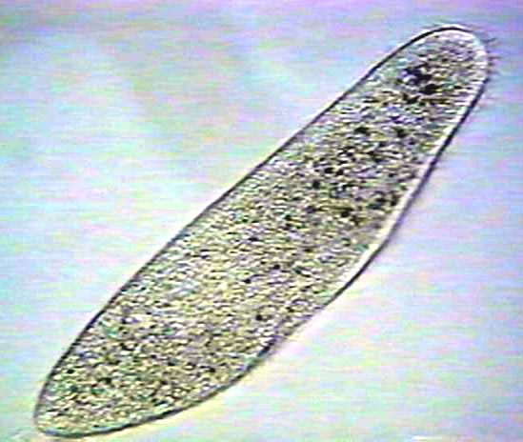
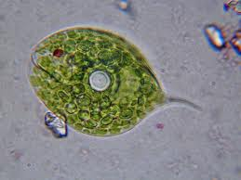
Kingdom Protista
Eukaryotes
Hetero and Auto
Unicellular
Mostly aquatic
Mostly asexual
Motile and non-motile
Ex: protozoa, slime molds, algae

Slide 9
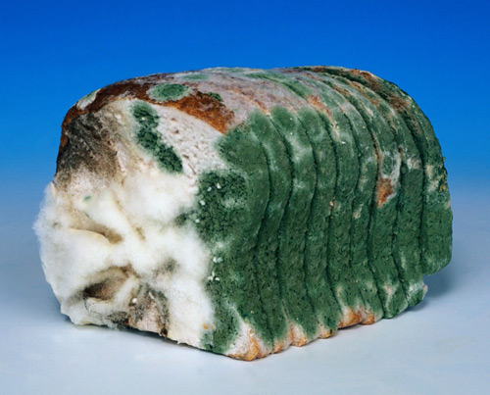
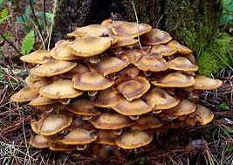
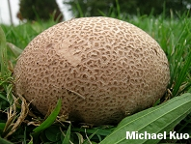
Kingdom Fungi
Eukaryote
Heterotrophic
Unicellular and Multi
Asexual and sexual
non-motile
Mushrooms, bread molds, yeasts, rust, puffballs

Slide 10
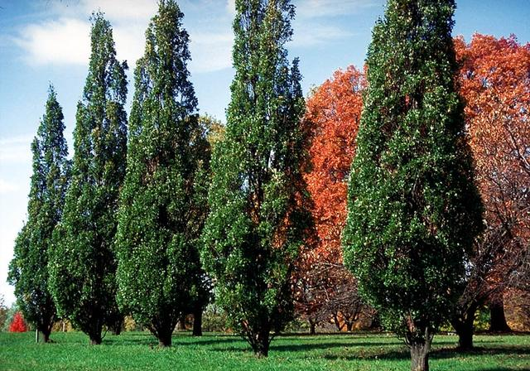
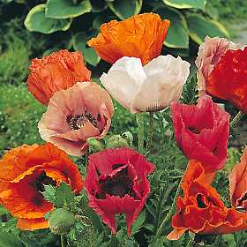
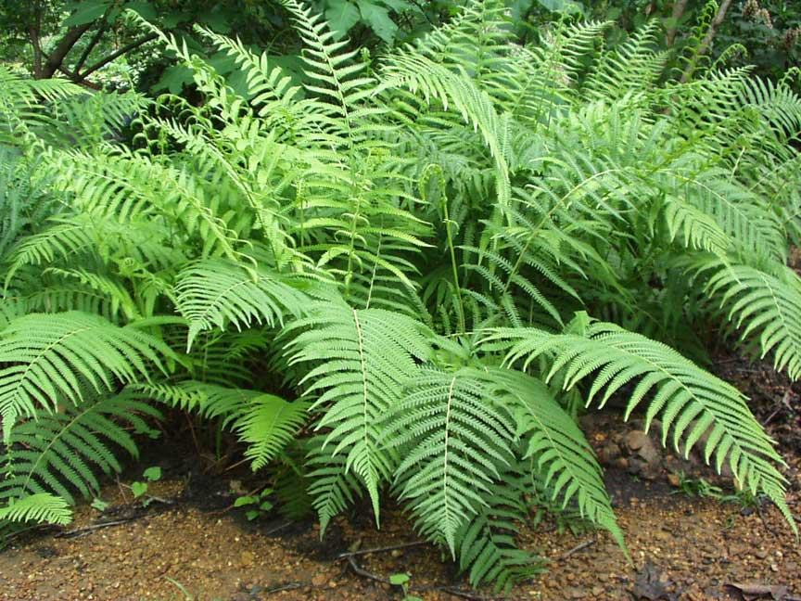
Kingdom Plante
Eukaryote
Multicellular
Autotrophic
Mostly Terrestrial
Asexual and sexual
Non-motile
Ex: mosses, ferns, conifers
and flowering plants

Slide 11
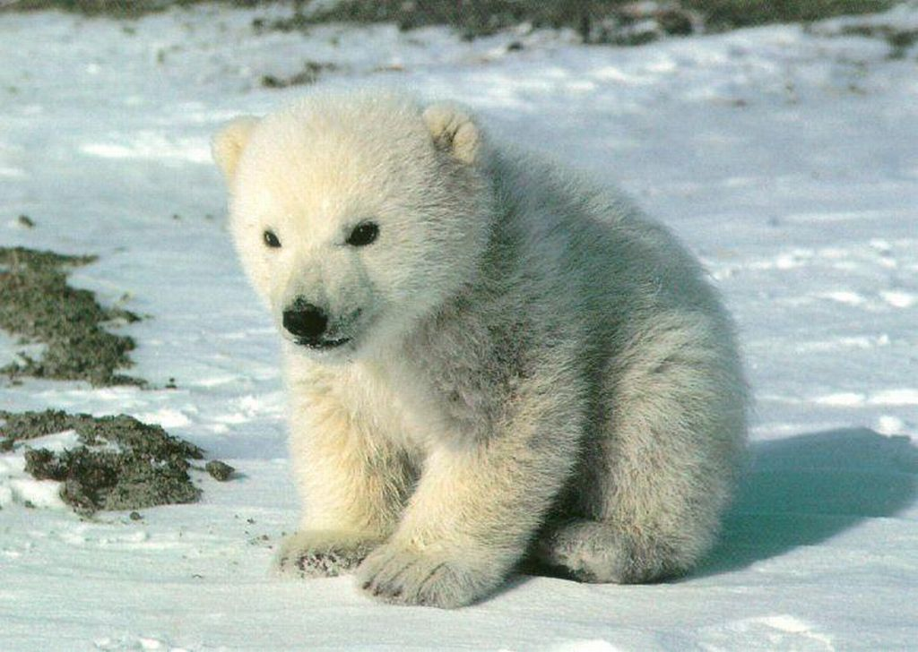
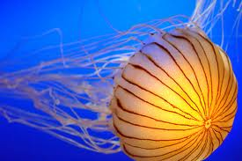
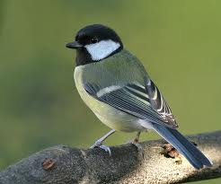
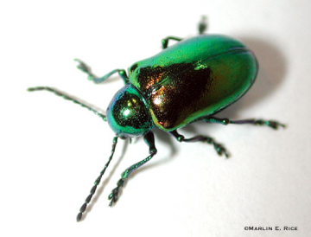
Kingdom Animalia
Eukaryote
Multicellular
Heterotrophic
Terrestrial, Aquatic
Sexual and asexual
Motile
Ex: sponges, jellyfish, worms, starfish, insects, reptiles, birds, mammals

