Slide 1
Unit II Part 3: Female Reproductive System

Slide 2
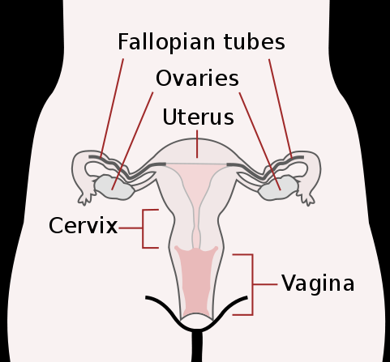
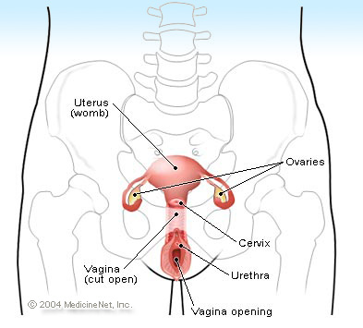
A. Female Reproductive Organs

Slide 3
1. Ovaries, Fallopian Tubes, Uterus, Cervix, Vagina

Slide 4
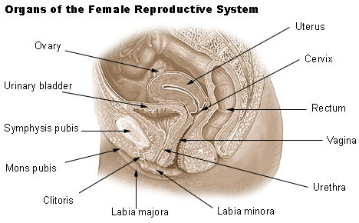

Slide 5
B. Purposes of the Female Reproductive System
1. To produce egg cells (ova)
2. To support a developing embryo (baby) during pregnancy (gestation)
3. Make Estrogen
- wider hips, fat deposits, enlarged breasts
- egg maturity.
- Preps the uterus for pregnancy each month, maintains the uterus during pregnancy

Slide 6
C. Oogenesis
- In womb, 2,000,000 germ cells (primary oocytes) in ovaries at Birth
- All halt in Pro I
- At puberty, 28 day cycle. FSH tells egg to complete first division stops at Meta II
- If fertilized, will divide again

Slide 11
D. The Menstrual (28-day) Cycle
Days 1-5: FLOW PHASE: The uterine lining is shed.
Days 6-14: FOLLICULAR PHASE: The endometrial lining thickens. Ovulation (the release of the new egg) occurs.
Days 14-28: LUTEAL PHASE: endometrium is prepared for pregnancy.
If the egg is not fertilized, the uterine lining is shed…Day 1 (Flow Phase)

Slide 12
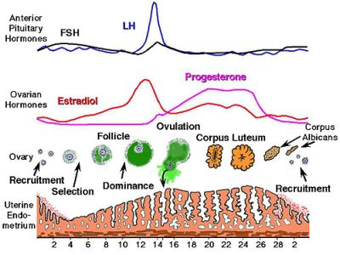

Slide 13
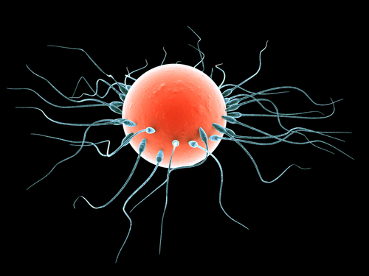
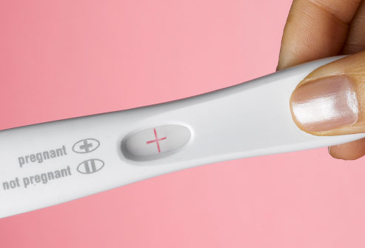
E. Pregnancy / Gestation
- If the egg is fertilized by a sperm cell, a zygote forms.
- A hollow ball of cells forms and implants in the lining of the uterus.
Blastocyst - 3 layers
1. endoderm (digestive system)
2. mesoderm (muscles)
3. ectoderm (skin & nerves).

Slide 14
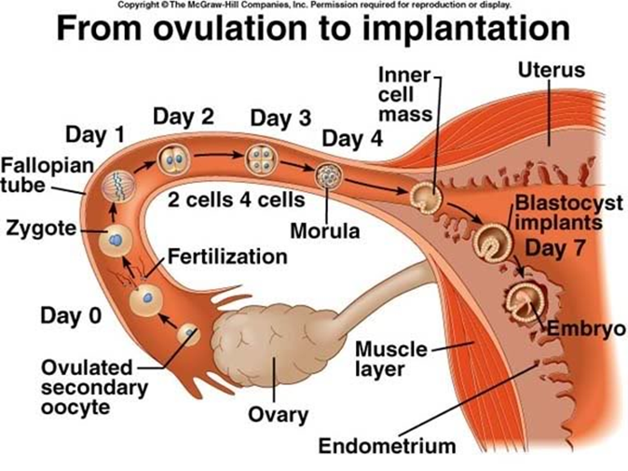

Slide 15
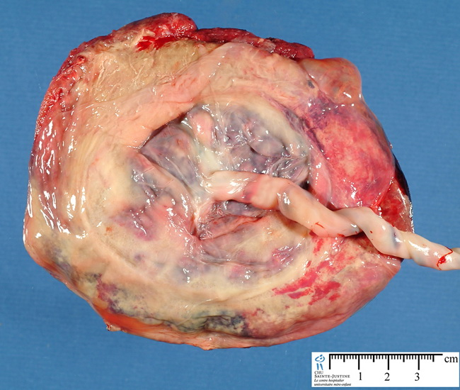
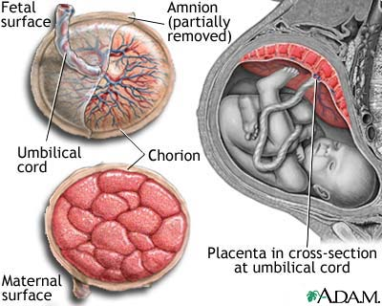

Slide 18
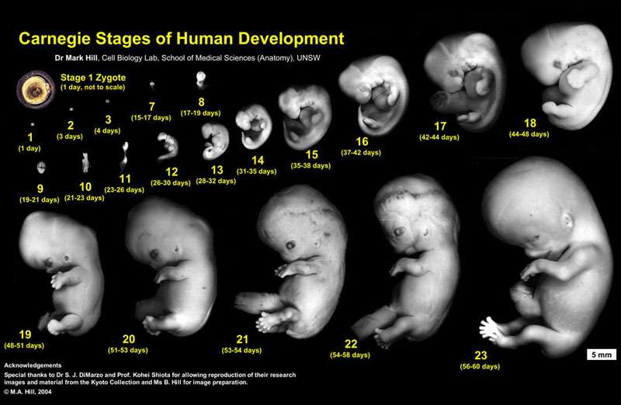
24 Random Facts about Pregnancy

Slide 19
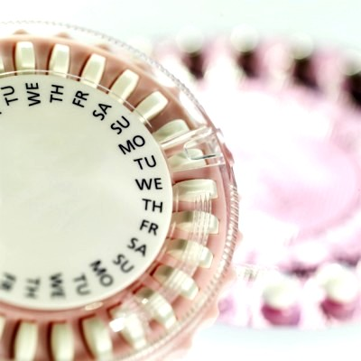
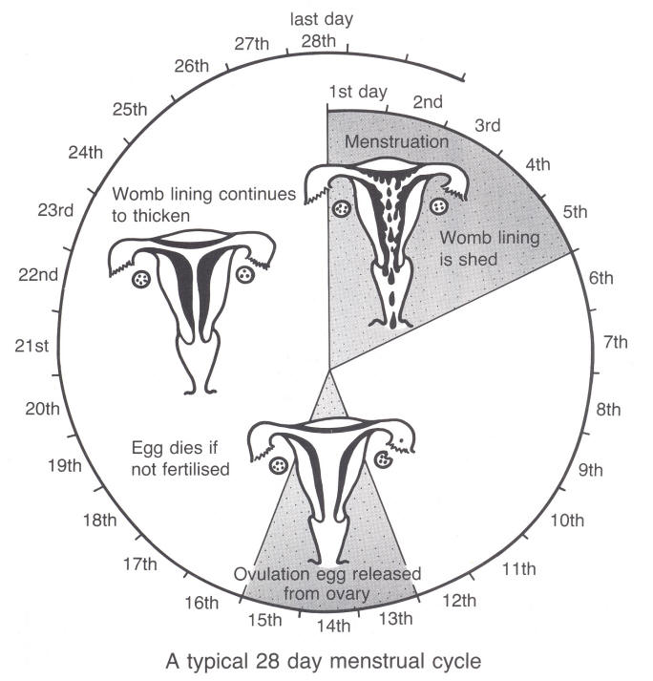

Slide 20
Other Questions???

